Slide 1
Why a student should do Transition Year...
In the opinion of a student

Slide 2
Going into Transition year
Students are just after finishing their Junior Certificate exams and three whole years of preparation.
Most students are between the ages of 15 and 16 and have received no career guidance in the junior cycle.

Slide 3
So why do 4th year?
A break from the usual study habits.
Helps you to understand, through experience, what the working world is like.
Helps you to grow as a person.
Guides you in areas surrounding career guidance, study techniques, subject choice.
Teaches you how to reflect on your experiences and get the most out of life.
Encourages you to explore the opportunities that are available.

Slide 4




Getting Involved
It’s vital to get involved in all aspects of Transition Year
Guest Speakers such as poets, jockeys, politicians etc.
Extra events such as Build A Bank Challenge, CAST Film Festival, Student Council etc.
Events
School events such as the Musical, Young Social Innovators, Enterprise, Graduation etc.
Significant Learning Experiences such as Surfing, Dail Trip, Titanic Visit etc.
General Class projects such as European Studies, History, Photography, Take on the Takeaway.

Slide 5
Growing as a person in Transition Year
For me Transition year was very helpful in order to get to know myself as a person. I learned things about myself that I never knew before.
I learned how to be positive and self confident
I learned how to be a leader
I learned how to interact with people in a respectful way
I learned to be tolerant of everyone’s abilities
I learned how to laugh at myself and not be so uptight
I developed social skills and became much closer with my year group as a whole.

Slide 6
Career Guidance
Without Transition Year, students are forced to make a
blind decision surrounding leaving cert subjects and potentially college courses.
TY gives you a chance to sample Leaving Cert subjects
TY lets you experience work in various areas you might be interested in
Aptitude Tests (e.g. DATS) help to show you what kind of learner you are i.e. what subjects might suit you
Classes such as Guidance and Pastoral Care give you an opportunity to explore courses and jobs that are available
Projects such as enterprise, YSI, Build a Bank etc. help you to learn new skills and find out talents that you may have been unaware of

Slide 7

Reflecting in Transition Year
One of the most important things for me in Transition Year was the reflective journals that we were required to keep.
We had to fill in these journals every day and there were specific sections for special events, guest speakers, workshops etc.
This helped me learn about myself. What I liked, what worked for me and what I could do to improve my TY experience.

Slide 8


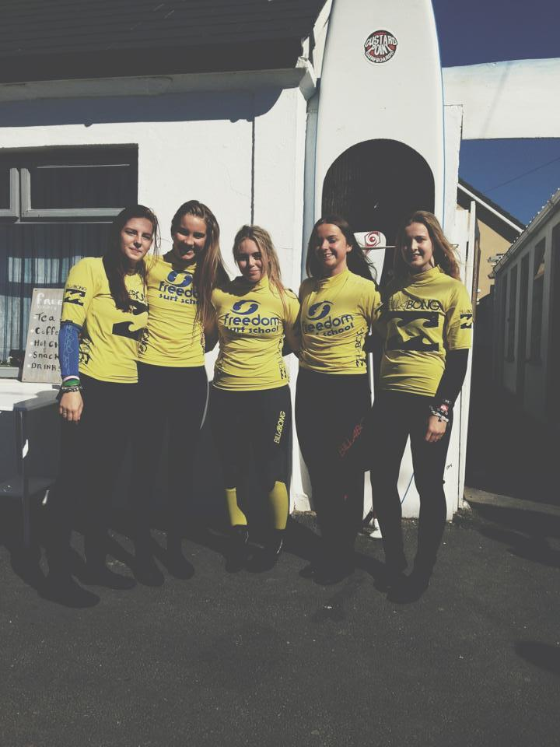

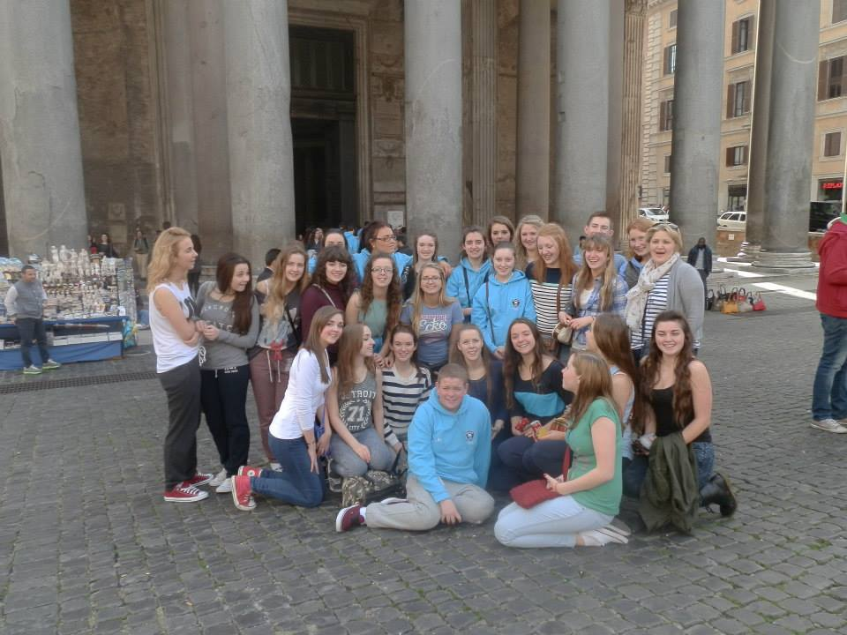

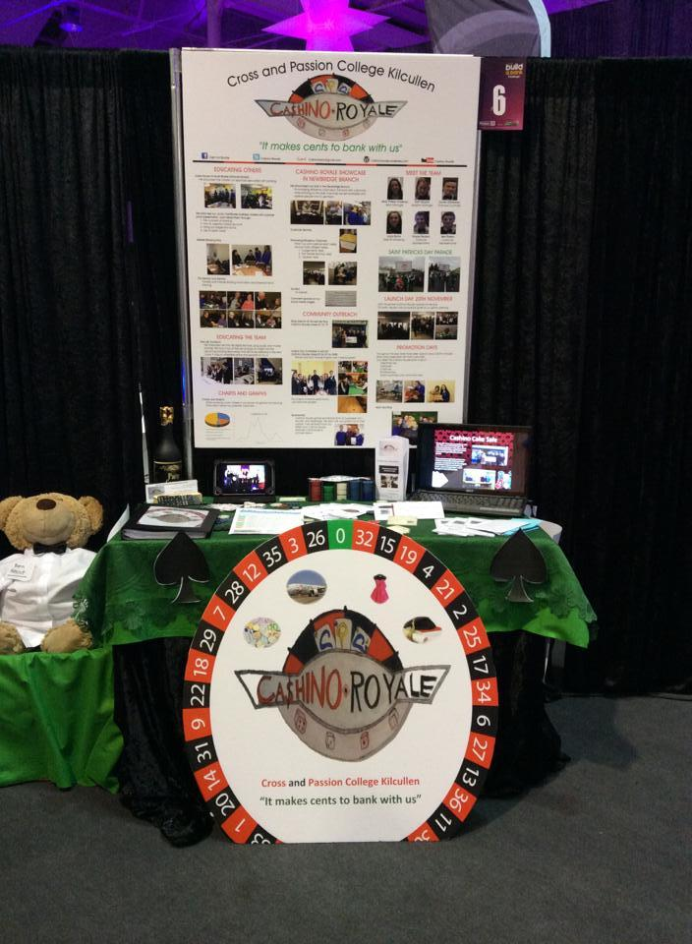

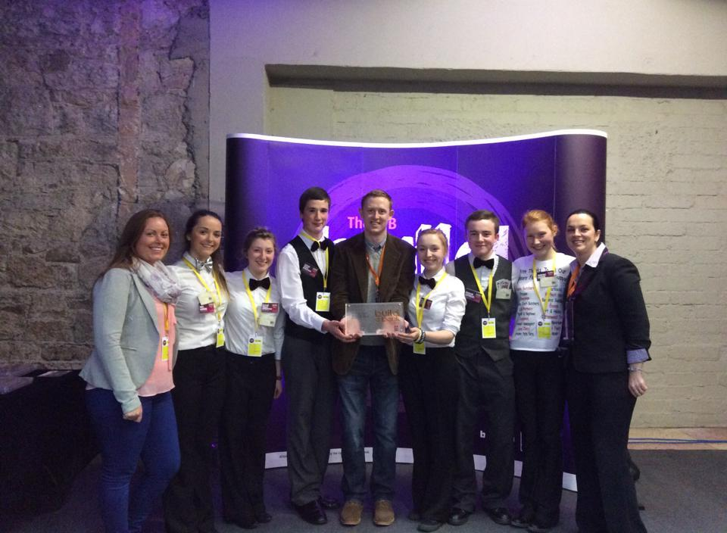

Leaving Transition Year: What I have done
School Trips: Italy, Surfing, The Dail.
Rotary Youth Leadership Trip to Strasbourg
Sports Achievements
AIB Build a Bank Challenge
The Musical
And so much more….

Slide 9
Leaving Transition Year: What I have learned
leadership
courage
social skills
organisational skills
I.T. skills
how to work in an office environment
humour
project skills
my learning styles
subjects that I like
positivity
confidence
self-motivation

Slide 10
Transition Year taught me through experiential learning so many things that can not be learned from a textbook.

